Slide 1


Premium Session
Data Science Project
Best Practices & Tips
KIRTHIKKA DEVI VENKATARAM
Lead at WWC Data Science

Slide 2
Session Agenda
Advanced evaluation methods and metric selection
Improving our project - advanced techniques
Implementing our project
Takeaways & Perks

Slide 3


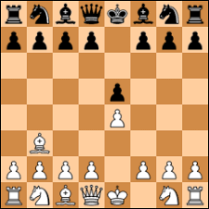
Machine Learning Problems
Supervised
Unsupervised
Reinforcement
Semi supervised

Slide 4
Data Science Life Cycle
Data Preparation
1
Metrics Evaluation
6
Identify Features
2
Model Evaluation
5
Building Model
3
Tuning HyperParameter
4

Slide 5
Types of Classification Problems
Binary Classification
Balanced Dataset Binary Classification
Imbalanced Dataset Binary Classification
Multiclass Classification

Slide 6
ML Classification Problem
ML Classification Problem - KPI & Metrics
Logistic Regression
K-Nearest Neighbors
Decision Trees
Support Vector Machines (SVM)
Naive Bayes
Accuracy
Precision
Recall
F1 Score
ROC
AUC
Entropy
Gini Index
Information Gain
Python: Libraries such as Scikit-Learn, TensorFlow, and PyTorch.

Slide 7
Types of Other Regression Problems
Linear Regression
Polynomial Regression
Ridge Regression
Lasso Regression

Slide 8
ML Regression Problem
ML Regression Problem - KPI & Metrics
Linear Regression
Polynomial Regression
Support Vector Regression
Decision Tree Regression
Random Forest Regression
Mean Absolute Error
Mean Squared Error
Root Mean Squared Error
Coefficient of Determination
Python: Libraries such as Scikit-Learn, TensorFlow, and PyTorch.

Slide 9
ML Models
Linear Regression
Logistics Regression
Decision Tree
Random Forest
Neural Networks

Slide 10
ML Model Evaluation & Validation methods
Hold-out
K-folds
Leave-one-out
Leave-p-out
Stratified K-folds
Repeated K-folds
Nested K-folds
Time series CV

Slide 11
KPI & Metrics - Machine Learning Problem
Link to General Evaluation Metrics

Slide 12
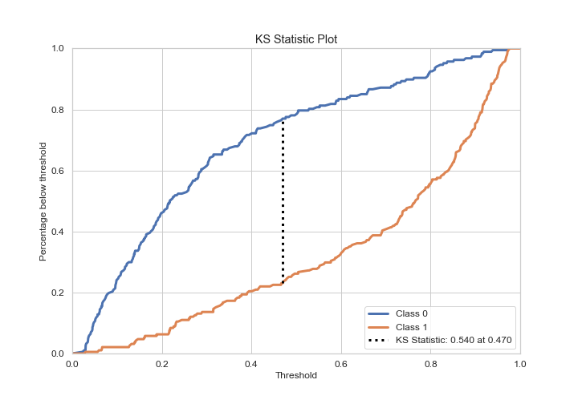
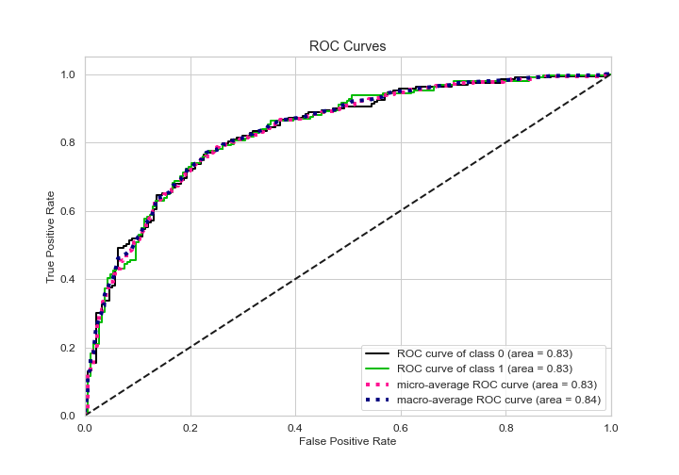
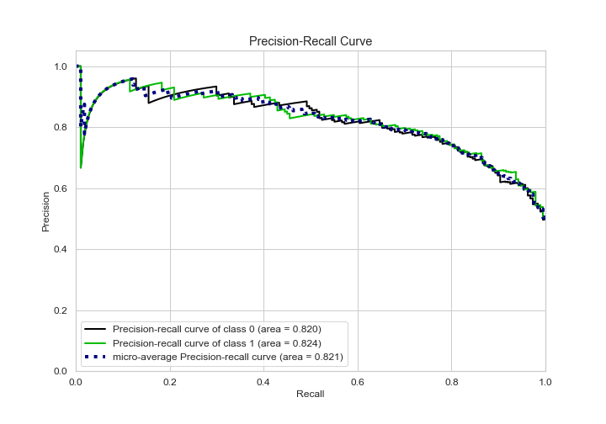
KPI identification

Slide 13
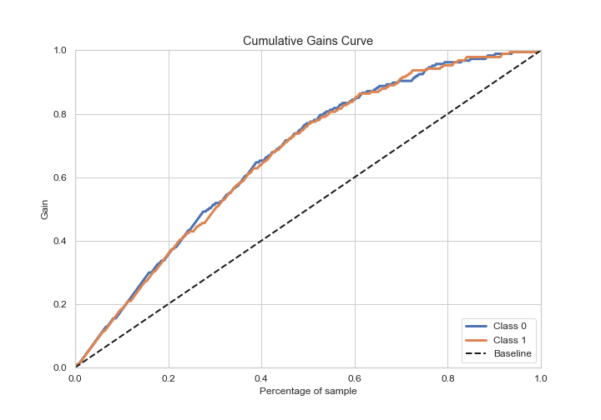
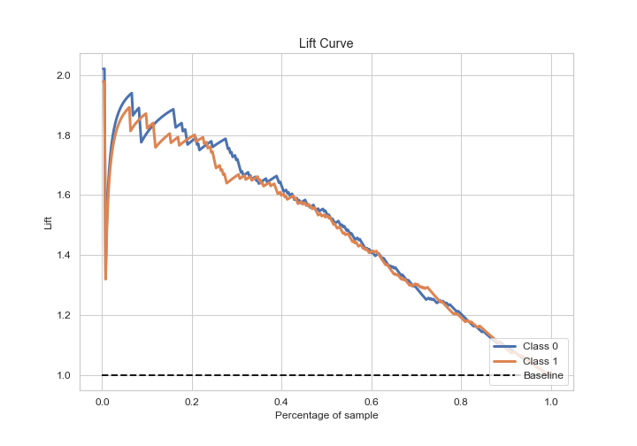
KPI identification

Slide 14
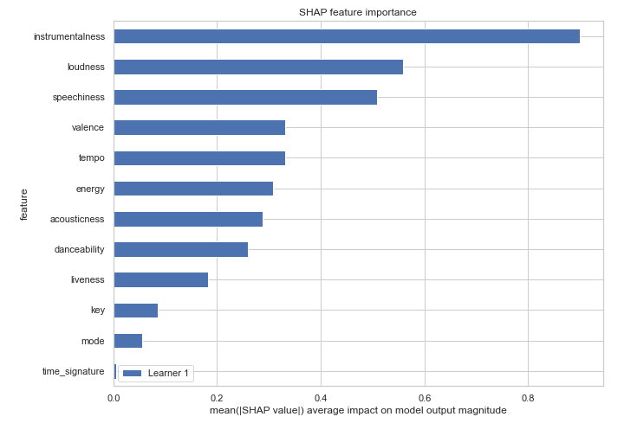
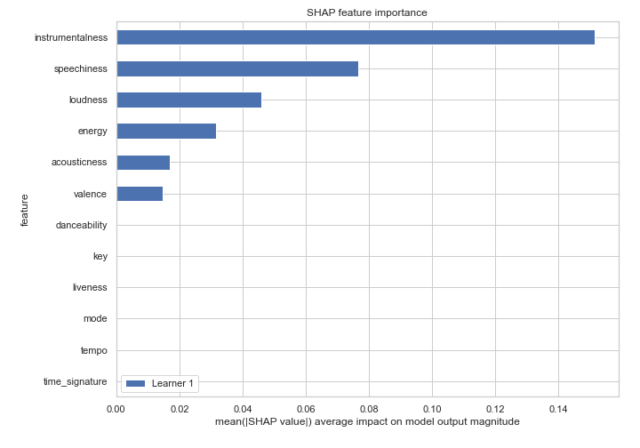
SHAP - SHapley Additive exPlanations
SHAP feature importance for XGBoost
SHAP feature importance for Decision Tree

Slide 15
AutoML Demo
Takeaways

Slide 16
Thank you!

